Slide 1

RemovAL OF reflections from images USING DEEP LEARNING
Presented by:
ADITYA PRATAP SINGH
ARYAN KUMAR

Slide 2
INTRODUCTION
In today's visually-driven world, the clarity of images is paramount. Yet, reflections from surfaces such as glass, water, and shiny materials can significantly degrade image quality, obscuring critical details.
SURVEILLANCE:
In security applications, reflections on glass can hinder the identification of individuals or objects, potentially compromising safety and security measures
In surveillance studies, reflections have been cited as a major factor leading to misidentifications in 30% of reviewed footage.
AUTONOMOUS VEHICLES:
For self-driving cars, reflections on windshields or nearby water bodies can obscure vital information, posing risks to navigation and decision-making processes.
Traditional methods for reflection removal often rely on manual editing or basic filtering techniques, which can be time-consuming and yield inconsistent results.
Deep learning techniques, particularly Generative Adversarial Networks (GANs) nad U-Net, have emerged as powerful tools for image processing tasks, enabling automated and high-quality enhancements.

Slide 3
OBJECTIVE
The primary objective of this project is to develop an advanced machine learning model that effectively removes reflections from images, thereby enhancing visual clarity and preserving important details.
Create an automated system that can detect and eliminate reflections in various types of images, reducing the need for manual editing.
ensure that the removal process does not compromise the quality of the original image, maintaining color accuracy, sharpness, and essential details.
EXPECTED OUTCOMES:
High-Fidelity Image Restoration: The image formed must be free from distracting reflections.
Broad Applicability: It can serve as a tool that can be used in various fields, including photography, security, and autonomous navigation.
User -Friendly Interface: A potential user interface that allows non-technical users to benefit from this technology without requiring specialized knowledge.

Slide 4
METHODOLOGY
Our methodology consists of a series of well-defined steps that leverage deep learning techniques, specifically the CycleGAN architecture , to effectively remove reflections from images.
There are six major steps which is represented by below flowchart:
DATA COLLECTION
Deployment
Model Evaluation
DATA PREPROCESSING
CycleGAN Architecture
Model Training

Slide 5
Steps for removal of reflection
STEP 1: DATA COLLECTION:
Gather a diverse dataset of images containing reflections across various surfaces such as glass, water, shiny materials which should also include reflection from sunlight.
The dataset will include both paired and unpaired image as the image may or may not have its corresponding non reflected visions.
STEP 2: DATA PREPROCESSING:
Resize images to a uniform dimension to ensure consistency.
Normalize pixel values to a range of [0, 1] to enhance model convergence.
Augment the dataset with transformations (rotation, flipping, etc.) to increase variability and robustness.

Slide 6
STEP 3: CYCLEGAN ARCHITECTURE:
Implement the CycleGAN model , which consists of two Generators and two Discriminators.
GENERATORS:
Generator G: Transforms images with reflections (X) to images without reflections (Y).
Generator F: Transforms images without reflections (Y) back to images with reflections (X).
DISCRIMINATORS:
Discriminator D_X: Distinguishes between real images with reflections and generated images.
Discriminator D_Y: Distinguishes between real images without reflections and generated images.
CYCLE CONSISTENCY LOSS:
Incorporate cycle consistency loss to ensure that the transformation from X to Y and back to X retains the original image structure.

Slide 7
STEP 4: TRAINING THE MODEL:
Utilize an appropriate loss function (e.g., adversarial loss, cycle loss) to optimize the model.
Implement techniques such as learning rate scheduling, early stopping, and regularization to enhance performance.
Monitor training progress using metrics like loss values and visual inspection of generated images.
STEP 5:EVALUATION OF THE THE MODEL:
Evaluate the performance of the trained CycleGAN and U-Net integrated model using a comprehensive evaluation framework.
Use qualitative evaluation (visual inspection of results) and quantitative metrics (PSNR, SSIM) to assess image quality.
Conduct user studies to gather feedback on the effectiveness of reflection removal.
STEP 6: DEPLOYMENT:
Deploy the model in a user-friendly application.
Create an interface that allows users to upload images and receive processed images with reflections removed.

Slide 8
TRAINING PROCESS
The training process involves multiple stages that ensure the CycleGAN model learns to effectively remove reflections from images while preserving essential details.
MODEL ARCHITECTURE:
The CycleGAN consists of two generators (G and F) and two discriminators (D_X and D_Y)
The generators learn to produce images that resemble the target domain, while the discriminators learn to distinguish between real and generated images.
The generators are responsible for transforming images with reflections into their corresponding non-reflected versions, leveraging the U-Net architecture to enhance feature extraction and preserve spatial information.
LOSS FUNCTIONS:
Adversarial Loss: Each discriminator uses binary cross-entropy loss to evaluate the authenticity of generated images.
Cycle Consistency Loss: This loss ensures that an image transformed to the target domain and back to the original domain remains unchanged.

Slide 9
TRAINING ALGORITHM:
Iterative Training: The training process alternates between updating the generators and the discriminators.
For each iteration perform the following steps:
Update Discriminators: Train D_X with real and generated images from G AND THEN Train D_Y with real and generated images from F.
Update Generators: Train G to minimize the adversarial loss while maximizing the cycle consistency loss. Similarly train F.
Epoches: Train the model for a predefined number of epochs (e.g., 100-200), monitoring performance on the validation set.

Slide 10
TRAINING TECHNIQUES:
Learning Rate Scheduling:
Implement a learning rate decay strategy to reduce the learning rate over time, improving convergence.
Early Stopping:
Monitor validation loss and stop training if performance does not improve for a set number of epochs to prevent overfitting.
Data Augmentation:
Apply random transformations (e.g., rotation, flipping, brightness adjustment) during training to enhance model robustness.

Slide 11

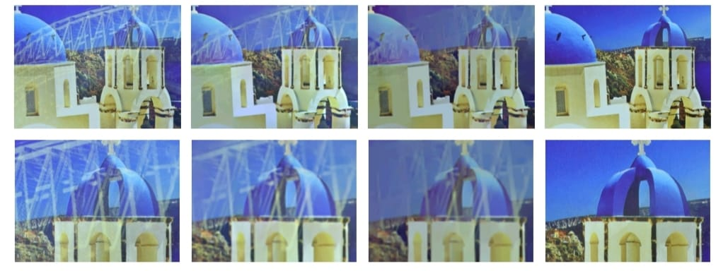
Results
The CycleGAN model was trained and evaluated on a dataset specifically curated for images with reflections, demonstrating notable improvements in image quality and clarity.
Results indicate that the model effectively removes reflections while preserving critical details necessary for security applications.
Peak Signal-to-Noise Ratio (PSNR)
Average PSNR values improved significantly post-reflection removal, indicating enhanced image clarity.
Structural Similarity Index (SSIM):
SSIM scores showed a marked increase, reflecting better structural integrity and perceptual quality of the images.

Slide 12
Real world applications
SURVEILLANCE:
Surveillance systems are often hindered by reflections caused by glass surfaces, lighting conditions, and environmental factors.
These reflections can obscure critical details, making it challenging to identify individuals, vehicles, and other important elements in security footage.
CycleGAN effectively removes reflections, resulting in clearer images that allow for better visibility of subjects.
With reflections minimized, object detection algorithms can operate more effectively, increasing the accuracy of recognizing people and vehicles.
TRAFFIC MANAGEMENT:
Real-Time Monitoring: Enhances visibility of traffic conditions and incidents, aiding in effective traffic management.
Accident Analysis: Improves clarity in footage for better assessment of accidents and quicker response times.

Slide 13
CONCLUSION
This project successfully demonstrated the effectiveness of the CycleGAN architecture in removing reflections from images.
Through rigorous training and evaluation, the model was able to achieve high fidelity in image restoration while preserving essential details.
Quantitative metrics such as PSNR and SSIM indicated significant improvements in image quality compared to original images with reflections.
IMPLICATIONS OF THE WORK:
Autonomous Navigation: This approach facilitates better visual perception for autonomous vehicles operating in environments with reflective surfaces.
Security and Surveillance: It improves the clarity of images captured in reflective environments, aiding in object recognition and identification form security cameras.
LIMITATIONS:
The model's performance may vary with different types of reflections and lighting conditions.
The reliance on unpaired datasets can introduce challenges in training stability and image quality.
Computational resources required for training GANs can be substantial, potentially limiting accessibility for some users.

Slide 14
FUTURE DIRECTIONS
Development of techniques for optimizing the model to enable real-time reflection removal in applications like live video streaming.
Explore the potential for the model to generalize across different domains, such as varying camera types and environmental conditions.
Investigate alternative architectures or enhancements to CycleGAN, such as incorporating attention mechanisms to improve performance.
In conclusion, the project has demonstrated the potential of deep learning techniques, particularly CycleGAN, in addressing common challenges in image processing.
By effectively removing reflections, we can significantly enhance visual communication and improve the quality of images in various applications.

Slide 15



